Slide 1


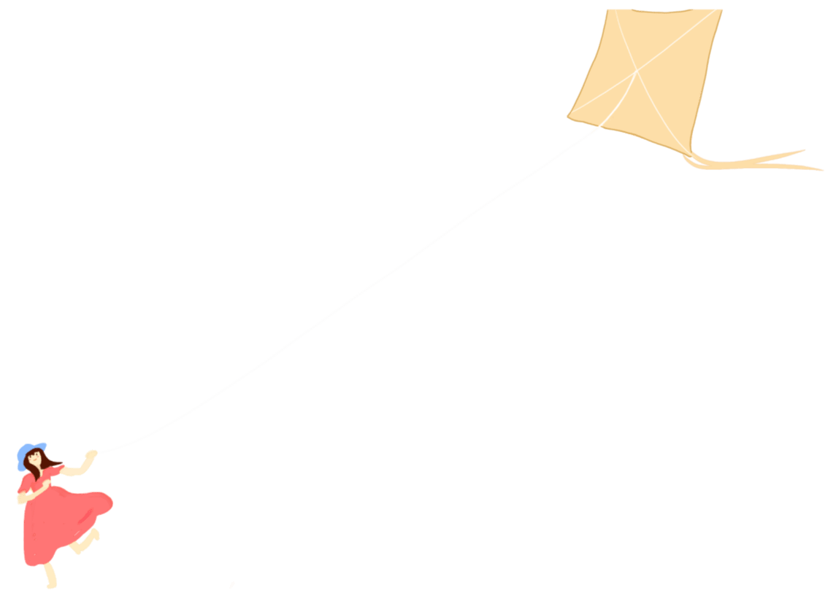

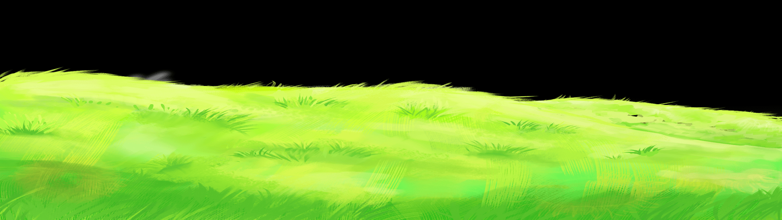

快/乐/暑/假/快/乐/生/活/快/乐/学/习
SUMMER HOLIDAYS
IN THE SUMMER VACATION, I LEARNED FROM MY MOTHER TO HOUSEWORK, COOK, WASH AND CUT VEGETABLES.
主讲人：优品PPT

Slide 2
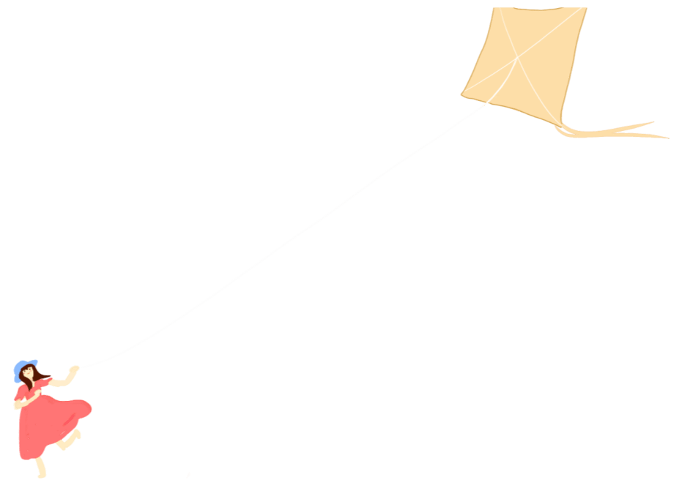
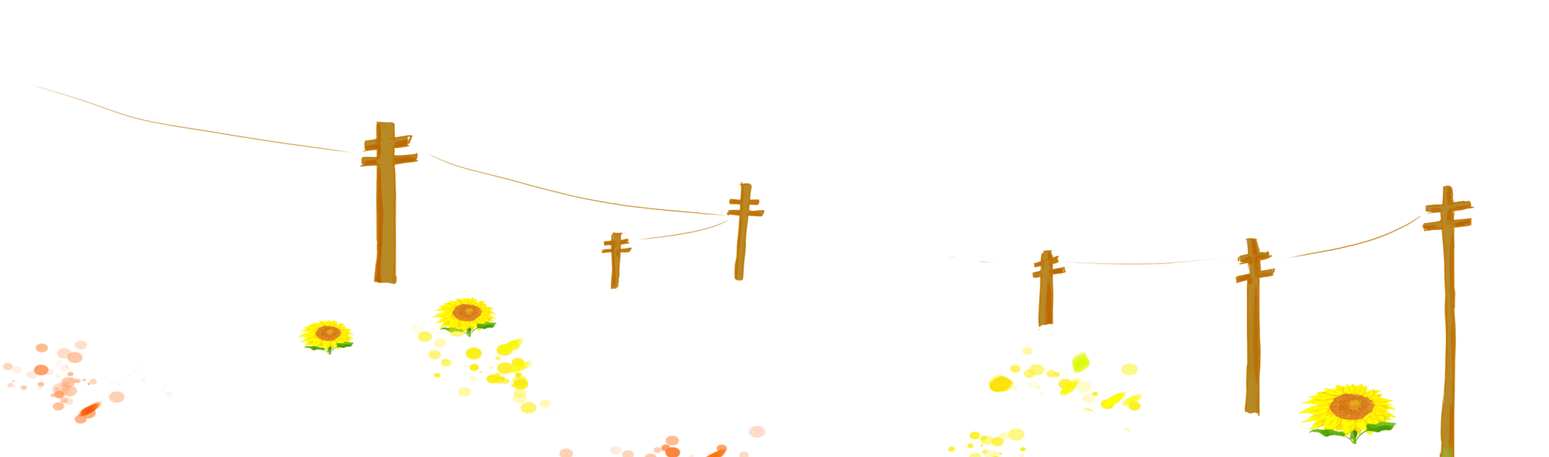

CONTENTS
01
My Life
02
My Study
03
My Amusements
04
My Gains

Slide 3

PART 01
MY LIFE
IN THE SUMMER VACATION, I LEARNED FROM MY MOTHER TO HOUSEWORK, COOK, WASH AND CUT VEGETABLES.

Slide 4
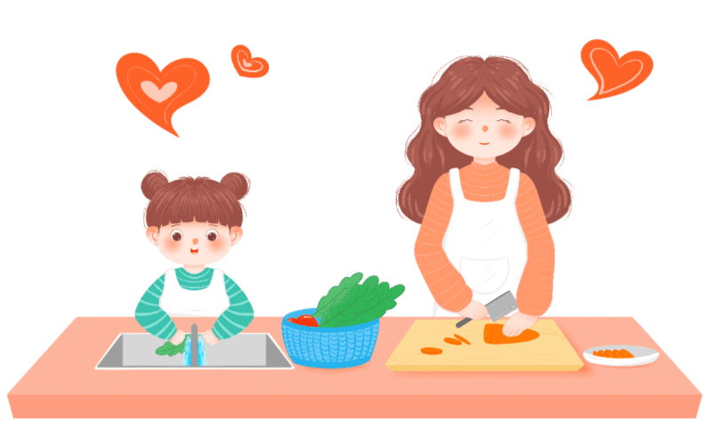
Doing Housework
https://www.ypppt.com/
In the summer vacation, I learned from my mother to do housework, cook, wash and cut vegetables.

Slide 5
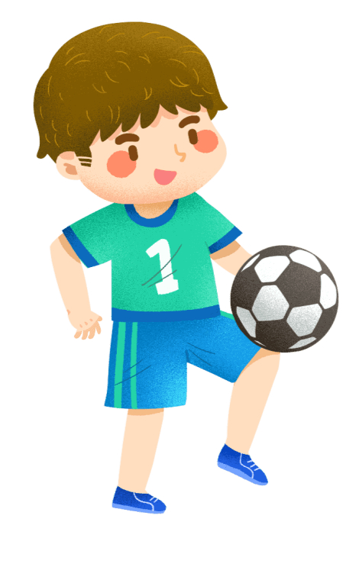
Exercing
I like sports, because it can not only strengthen my body, but also make me know many friends!

Slide 6
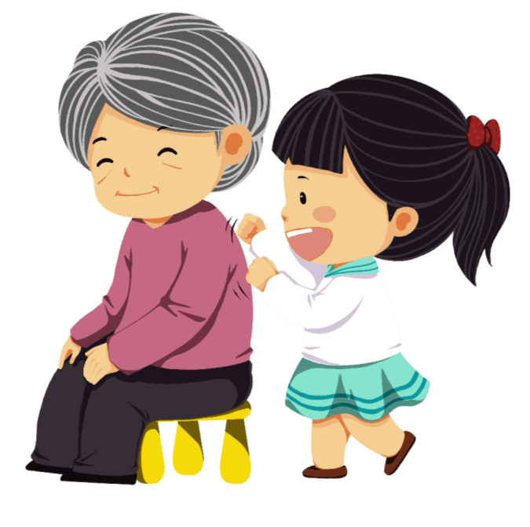
Visiting Relatives And Friends
My parents took me to visit my grandparents and grandparents.

Slide 7
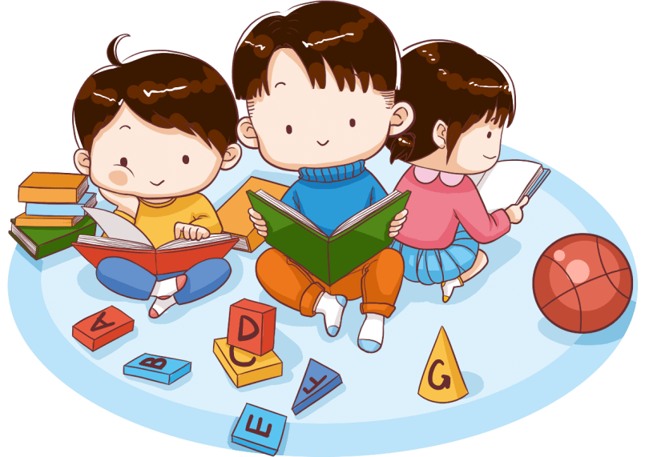
Happy Time With Friends
During the summer vacation, I went to the library to study and watch movies with my good friends.

Slide 8
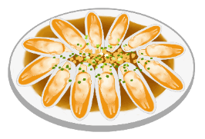
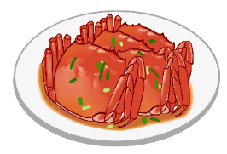
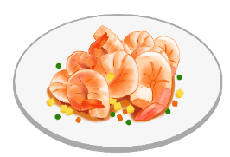
My Favorite Food
My favorite food
My favorite food
My favorite food
Please enter the reason why you like it
Please enter the reason why you like it
Please enter the reason why you like it
PPT模板 http://www.1ppt.com/moban/

Slide 9
PART 02
MY STUDY
IN THE SUMMER VACATION, I LEARNED FROM MY MOTHER TO HOUSEWORK, COOK, WASH AND CUT VEGETABLES.

Slide 10
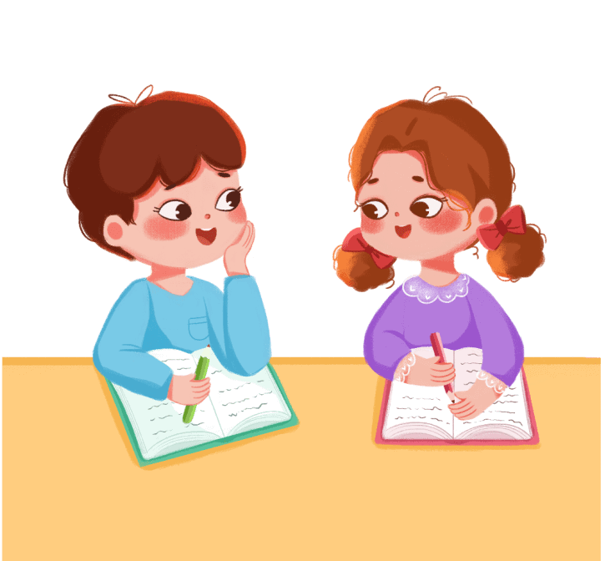
Doing Homework
In this summer vacation, I seriously finished all the homework assigned by the teacher.
Notes:
https://www.ypppt.com/

Slide 11

Reading
In reading, I can find a big truth from a small story. Reading gives me endless fun. I can also find good words and sentences from the story and inspiration in daily life.

Slide 12
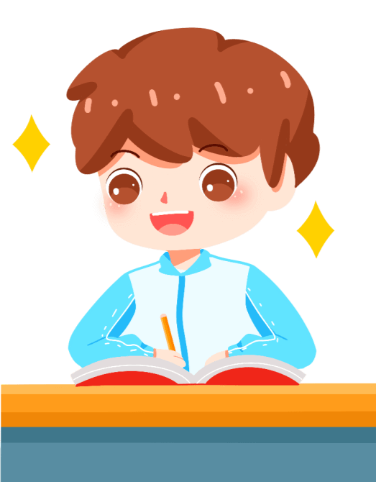
Learn To Write Calligraphy
When writing calligraphy, my heart must calm down. I believe I can write good calligraphy in the future.

Slide 13
PART 03
MY AMUSEMENTS
IN THE SUMMER VACATION, I LEARNED FROM MY MOTHER TO HOUSEWORK, COOK, WASH AND CUT VEGETABLES.

Slide 14
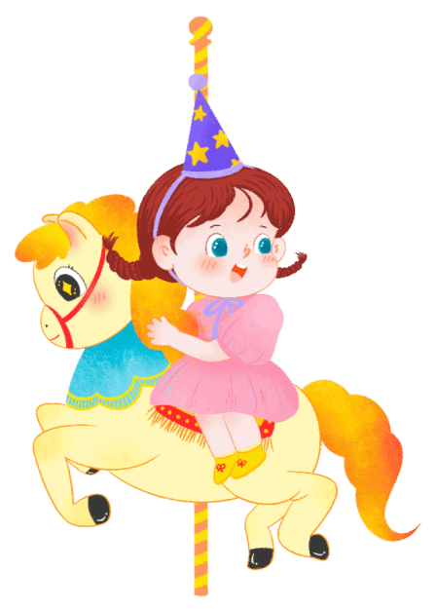
To The Playground
I Went To The Playground With My Parents
I took a merry go round and played with bumper cars. There is also a clown in the playground, red nose, big mouth, holding a lot of balloons and greeting us!

Slide 15
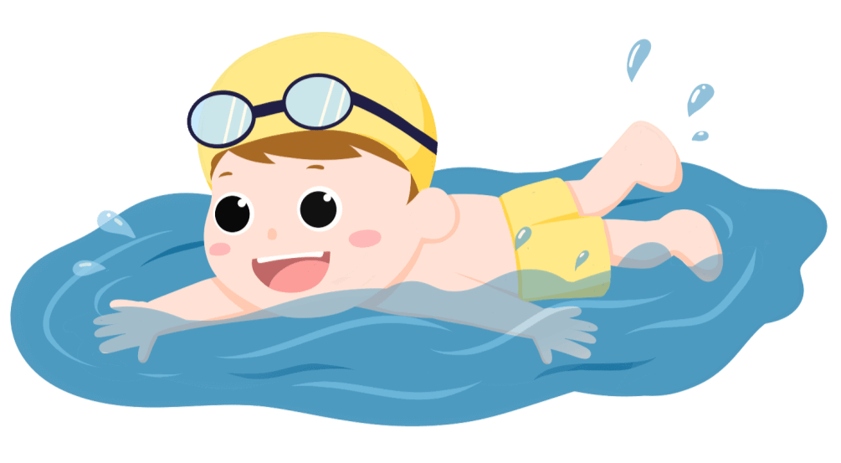
Swimming
My parents took me swimming at the seaside.

Slide 16
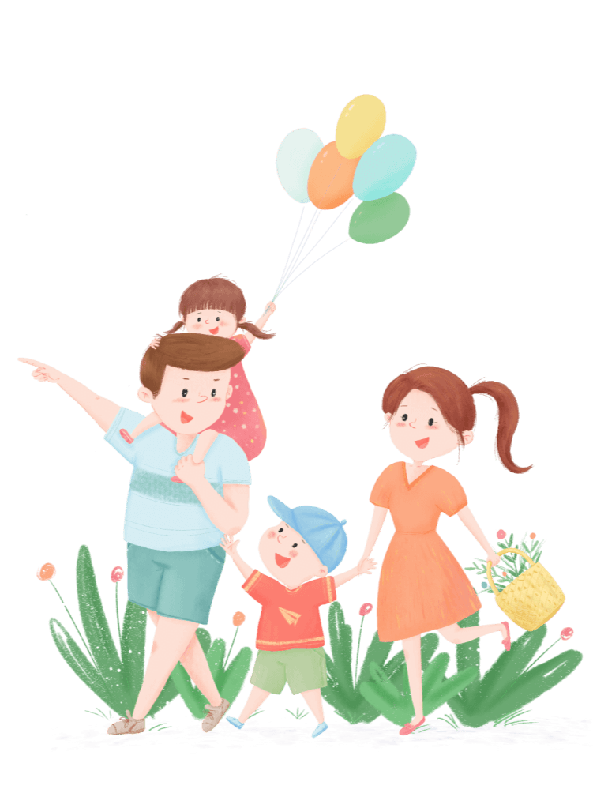
Travelling
My parents also took me to Jiangmen to play. There I saw a fisherman carved with stone. I was still wondering if it was Mazu, the God of the sea?.

Slide 17
PART 04
MY GAINS
IN THE SUMMER VACATION, I LEARNED FROM MY MOTHER TO HOUSEWORK, COOK, WASH AND CUT VEGETABLES.

Slide 18
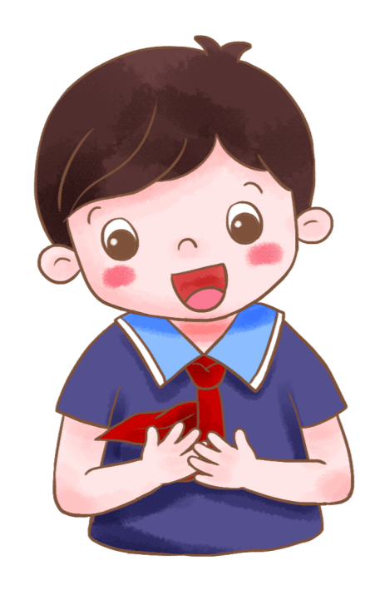
This summer vacation, I have been tempered by life through labor, happy in entertainment and improved in study.

Slide 19
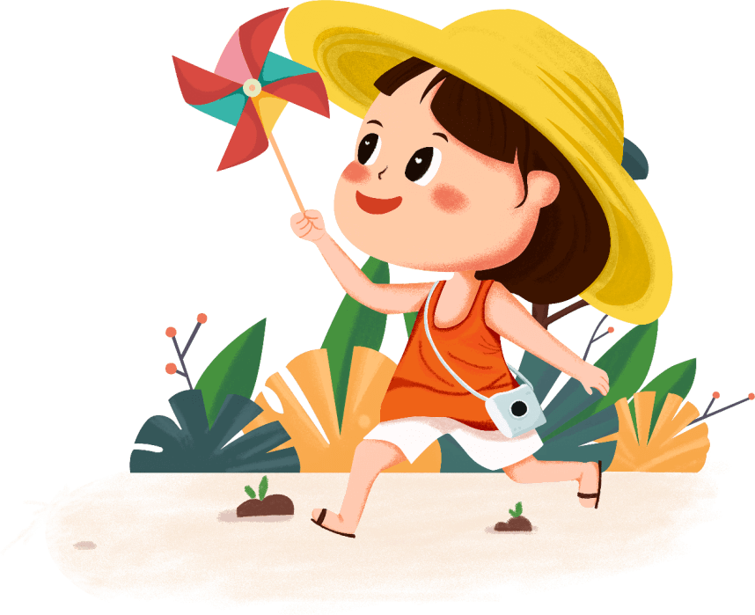
I also learned to play chess and joined the chess club. Every time I play chess, I am the "general" who always wins among my peers. Even so, sometimes we sometimes lose one or two games.

Slide 20
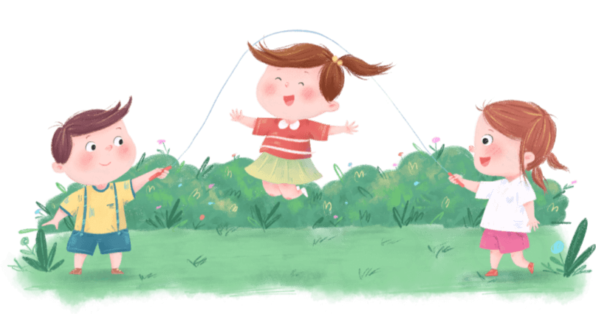
With the help of my mother, I learned to make plans. I also deeply realized that to do a good job, we can't start blindly. Only by starting step by step according to the plan can we do better and combine work and rest.
This summer vacation, I also went to a lot of places, saw a lot of scenery and saw a lot of local customs.

Slide 21
快/乐/暑/假/快/乐/生/活/快/乐/学/习
SUMMER HOLIDAYS
IN THE SUMMER VACATION, I LEARNED FROM MY MOTHER TO HOUSEWORK, COOK, WASH AND CUT VEGETABLES.
主讲人：优品PPT

Slide 22
更多精品PPT资源尽在—优品PPT！
www.ypppt.com
PPT模板下载：www.ypppt.com/moban/ 节日PPT模板：www.ypppt.com/jieri/
PPT背景图片：www.ypppt.com/beijing/ PPT图表下载：www.ypppt.com/tubiao/
PPT素材下载： www.ypppt.com/sucai/ PPT教程下载：www.ypppt.com/jiaocheng/
字体下载：www.ypppt.com/ziti/ 绘本故事PPT：www.ypppt.com/gushi/
PPT课件：www.ypppt.com/kejian/
Notes:
模板来自于 优品PPT https://www.ypppt.com/

