Slide 1
【框架完整·结构完整·专业配色·专业图表】
财务报告PPT模板
资产负债表 | 利润表 | 现金流量表 | 财务状况
汇报人：优品PPT
职务：财务经理

Slide 2
https://www.ypppt.com/
CONTENTS
01
标题文字内容
02
标题文字内容
The user can demonstrate on a projector or computer, or presentation
The user can demonstrate on a projector or computer, or presentation
03
标题文字内容
04
标题文字内容
The user can demonstrate on a projector or computer, or presentation
The user can demonstrate on a projector or computer, or presentation

Slide 3
PART.01
标题文字内容
Each day is a new beginning Seize new opportunities from now on Each day is
a new beginning Seize new opportunities from now onEach day is a new beginning Seize new opportunities from now on

Slide 4
在此您的标题
在此您的标题
标题文字添加
标题文字添加
The user can demonstrate on a projector or computer, or presentation and make it film to be used in a wider field
The user can demonstrate on a projector or computer, or presentation and make it film to be used in a wider field

Slide 5
单击此处输入标题
The user can demonstrate on a projector or computer, or print the presentation and
单击此处输入标题
The user can demonstrate on a projector or computer, or print the presentation and
12
标题文字添加
%
The user can demonstrate on a projector or computer, or print the presentation and make it into a film to be used

Slide 7
单击此处输入标题
The user can demonstrate on a projector or computer, or print the presentation and make it into a film to be used
单击此处输入标题
The user can demonstrate on a projector or computer, or print the presentation and make it into a film to be used
PPT下载 http://www.ypppt.com/xiazai/

Slide 8
PART.02
标题文字内容
Each day is a new beginning Seize new opportunities from now on Each day is
a new beginning Seize new opportunities from now onEach day is a new beginning Seize new opportunities from now on

Slide 9
标题文字添加
添加
标题
The user can demonstrate on a projector or computer, or presentation and make it film to be used in a wider field
标题文字添加
添加
标题
The user can demonstrate on a projector or computer, or presentation and make it film to be used in a wider field

Slide 10
标题添加
The user can demonstrate on a projector or computer, or print the presentation and make it into a film to be usedThe user can demonstrate on a projector or computer, or print the
标题添加
The user can demonstrate on a projector or computer, or print the presentation and make it into a film to be usedThe user can demonstrate on a projector or computer, or print the

Slide 11
单击此处输入标题
The user can demonstrate on a projector or computer, or print the presentation and
单击此处输入标题
The user can demonstrate on a projector or computer, or print the presentation and
20XX
2021
2022
2020
单击此处输入标题
The user can demonstrate on a projector or computer, or print the presentation and
单击此处输入标题
The user can demonstrate on a projector or computer, or print the presentation and

Slide 12
TO
标题文字添加
The user can demonstrate on a projector or computer, or presentation and make it film to be used in a wider field
标题文字添加
The user can demonstrate on a projector or computer, or presentation and make it film to be used in a wider field
标题文字添加
The user can demonstrate on a projector or computer, or presentation and make it film to be used in a wider field
Notes:
https://www.ypppt.com/

Slide 13
PART.03
标题文字内容
Each day is a new beginning Seize new opportunities from now on Each day is
a new beginning Seize new opportunities from now onEach day is a new beginning Seize new opportunities from now on

Slide 14
标题文字添加
标题文字添加
The user can demonstrate on a projector or computer, or presentation and make it film to be used in a wider field
The user can demonstrate on a projector or computer, or presentation and make it film to be used in a wider field
标题文字添加
标题文字添加
The user can demonstrate on a projector or computer, or presentation and make it film to be used in a wider field
The user can demonstrate on a projector or computer, or presentation and make it film to be used in a wider field

Slide 15
标题文字添加
标题文字添加
The user can demonstrate on a projector or computer, or print the presentation and make it into a film to be used in a wider field. Using PowerPoint,
The user can demonstrate on a projector or computer, or print the presentation and make it into a film to be used in a wider field. Using PowerPoint,
标题文字添加:
标题文字添加:
The user can demonstrate on a projector or computer, or print the presentation and make it into a film to be used
The user can demonstrate on a projector or computer, or print the presentation and make it into a film to be used

Slide 16
标题文字添加
The user can demonstrate on a projector or computer, or presentation and make it film to be used in a wider field
100
80
78
标题文字添加
66
The user can demonstrate on a projector or computer, or presentation and make it film to be used in a wider field
60
52
40
35
标题文字添加
20
The user can demonstrate on a projector or computer, or presentation and make it film to be used in a wider field
文字添加
文字添加
文字添加
文字添加

Slide 17
标题文字添加
The user can demonstrate on a projector or computer, or presentation and make it film to be used in a wider field
标题文字添加
The user can demonstrate on a projector or computer, or presentation and make it film to be used in a wider field
标题文字添加
标题文字添加
The user can demonstrate on a projector or computer, or presentation and make it film to be used in a wider field
The user can demonstrate on a projector or computer, or presentation and make it film to be used in a wider field

Slide 18
PART.04
标题文字内容
Each day is a new beginning Seize new opportunities from now on Each day is
a new beginning Seize new opportunities from now onEach day is a new beginning Seize new opportunities from now on

Slide 19
标题文字添加
标题文字添加
标题文字添加
标题文字添加
print the presentation and make it into a film to be used in a wider field
print the presentation and make it into a film to be used in a wider field
print the presentation and make it into a film to be used in a wider field
print the presentation and make it into a film to be used in a wider field

Slide 20
标题文字添加
The user can demonstrate on a projector or computer, or presentation and make it film to be used in a wider field
标题文字添加
The user can demonstrate on a projector or computer, or presentation and make it film to be used in a wider field
标题文字添加
The user can demonstrate on a projector or computer, or presentation and make it film to be used in a wider field

Slide 21
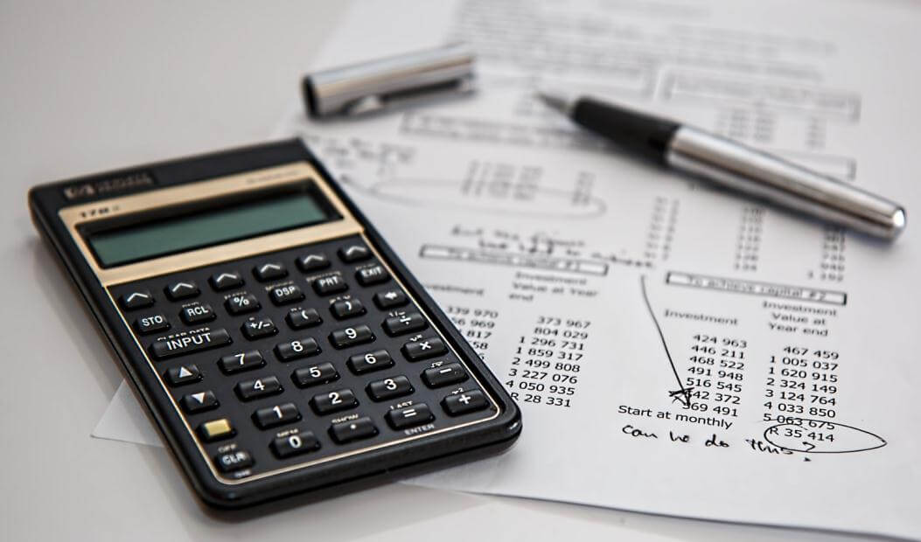
标题添加
The user can demonstrate on a projector or computer, or print the presentation and make it into a film to be usedThe user can demonstrate on a projector or computer, or print the
标题添加
The user can demonstrate on a projector or computer, or print the presentation and make it into a film to be usedThe user can demonstrate on a projector or computer, or print the

Slide 22
30%
70%
55%
90%
标题文字添加
标题文字添加
标题文字添加
标题文字添加
print the presentation and make it into a film to be used in a wider field
print the presentation and make it into a film to be used in a wider field
print the presentation and make it into a film to be used in a wider field
print the presentation and make it into a film to be used in a wider field

Slide 23
【框架完整·结构完整·专业配色·专业图表】
THANK YOU
资产负债表 | 利润表 | 现金流量表 | 财务状况
汇报人：优品PPT
职务：财务经理

Slide 24
更多精品PPT资源尽在—优品PPT！
www.ypppt.com
PPT模板下载：www.ypppt.com/moban/ 节日PPT模板：www.ypppt.com/jieri/
PPT背景图片：www.ypppt.com/beijing/ PPT图表下载：www.ypppt.com/tubiao/
PPT素材下载： www.ypppt.com/sucai/ PPT教程下载：www.ypppt.com/jiaocheng/
字体下载：www.ypppt.com/ziti/ 绘本故事PPT：www.ypppt.com/gushi/
PPT课件：www.ypppt.com/kejian/
Notes:
模板来自于 优品PPT https://www.ypppt.com/

