Slide 1

梦想正开始
Graduation season
青春不毕业
让我们迈开双腿，去洒一行汗水，去踏一路雷声！校门外，有的是鲜花簇拥的前程！

Slide 2

青春，是敢于忠于自己
Wherever you are, and whoever you may be, there is one thing in which you and I are just alike at this moment, and in all the moments of our existence.
KEYWORDS

Slide 3


我们心里
都有个老地方
像从前一样
Wherever you are, and whoever you may be, there is one thing in which you and I are just alike at this moment, and in all the moments of our existence.

Slide 4

离别的季节
在栀子花的香气里
迎来了毕业
Wherever you are, and whoever you may be, there is one thing in which you and I are just alike at this moment, and in all the moments of our existence. Wherever you are, and whoever you may be, there is one thing in which you and I are just alike at this moment, and in all the moments of our existence.
Wherever you are, and whoever you may be, there is one thing in which you and I are just alike at this moment, and in all the moments of our existence.

Slide 5

——photo albums
照片记录着过去
心理藏着我和你
Wherever you are, and whoever you may be, there is one thing in which you and I are just alike at this moment, and in all the moments of our existence.

Slide 6

曾以为
毕业是一个结束其实他也是一个开始
Wherever you are, and whoever you may be, there is one thing in which you and I are just alike at this moment, and in all the moments of our existence.
KEYWORDS

Slide 7

愿以梦为马
不负韶华
莫愁前路无知己
天下谁人不识君
Our life is a movement, a tendency, a steady, ceaseless progress towards an unseen goal.
/ WHATEVER YOU ARE AND WHATEVER YOU MAY.
PPT下载 http://www.1ppt.com/xiazai/

Slide 8

黑板上的字迹
是青春划过的痕迹
Wherever you are, and whoever you may be, there is one thing in which you and I are just alike at this moment, and in all the moments of our existence.
KEYWORDS

Slide 9
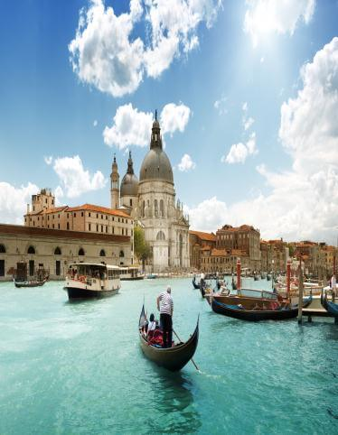
Wherever you are, and whoever you may be, there is one thing in which you and I are just alike at this moment, and in all the moments of our existence.
照片记录着欢乐
心理有你我的存在

Slide 10


【毕业季】
Wherever you are, and whoever you may be, there is one thing in which you and I are just alike at this moment, and in all the moments of our existence.
最难开口的就是
初次的问好
和最终的道别
Wherever you are, and whoever you may be, there is one thing in which you and I are just alike at this moment, and in all the moments of our existence.
【毕业季】
Wherever you are, and whoever you may be, there is one thing in which you and I are just alike at this moment, and in all the moments of our existence.

Slide 11

怕口口声声的朋友
变成唯唯诺诺的路人
Wherever you are, and whoever you may be, there is one thing in which you and I are just alike at this moment, and in all the moments of our existence.
Wherever you are, and whoever you may be, there is one thing in which you and I are just alike at this moment, and in all the moments of our existence.
Wherever you are, and whoever you may be, there is one thing in which you and I are just alike at this moment, and in all the moments of our existence.

Slide 12

后来才说
梦想荒芜
年少时
只义无反顾
Wherever you are, and whoever you may be, there is one thing in which you and I are just alike at this moment, and in all the moments of our existence.

Slide 13

珍贵的是
曾经只对视
就会脸红
【毕业季】
Wherever you are, and whoever you may be, there is one thing in which you and I are just alike at this moment, and in all the moments of our existence.
Wherever you are, and whoever you may be, there is one thing in which you and I are just alike at this moment, and in all the moments of our existence.

Slide 14
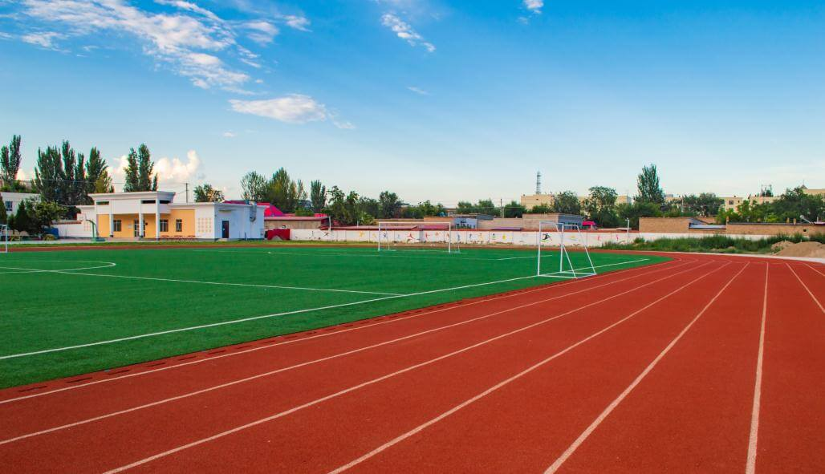
整本书
不要只记得abandon希望能背到victory
Wherever you are, and whoever you may be, there is one thing in which you and I are just alike at this moment, and in all the moments of our existence.

Slide 15
后来的我们
青春
是敢于忠于自己

Slide 16

后来才说梦想荒芜
年少时只义无反顾
Wherever you are, and whoever you may be, there is one thing in which you and I are just alike at this moment, and in all the moments of our existence.

Slide 17

我们心里
都有个老地方
像从前一样
Wherever you are, and whoever you may be, there is one thing in which you and I are just alike at this moment, and in all the moments of our existence.

Slide 18

老师教我们把自己
介绍给大家
却忘了教我们
如何向大家告别
Our life is a movement, a tendency, a steady, ceaseless progress towards an unseen goal.

Slide 19

以前总想有自己的空间以后想见面也难

Slide 20

我们珍惜
在一起的时光
不负你我的陪伴
Wherever you are, and whoever you may be, there is one thing in which you and I are just alike at this moment, and in all the moments of our existence.

Slide 21

青春是我们的别称
也是我们友谊的见证
Wherever you are, and whoever you may be, there is one thing in which you and I are just alike at this moment, and in all the moments of our existence.

Slide 22

青春不是
一段时光
而是那一群人
Wherever you are, and whoever you may be, there is one thing in which you and I are just alike at this moment, and in all the moments of our existence.

Slide 23
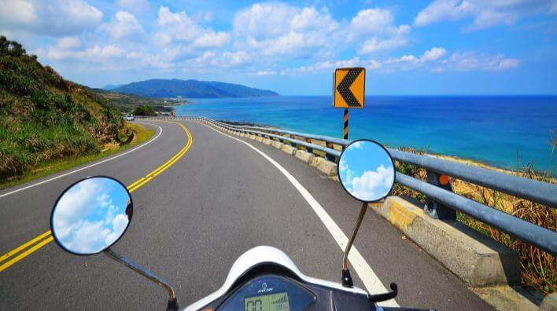
Thanksgiving Father's Day photo albums
尚未佩妥剑
转眼便是江湖
愿历尽千帆
归来仍少年

Slide 24

梦想正开始
Graduation season
尚未佩妥剑，
转眼便是江湖，
愿历尽千帆
归来仍少年。

Slide 25
更多精品PPT资源尽在—优品PPT！
www.ypppt.com
PPT模板下载：www.ypppt.com/moban/ 节日PPT模板：www.ypppt.com/jieri/
PPT背景图片：www.ypppt.com/beijing/ PPT图表下载：www.ypppt.com/tubiao/
PPT素材下载： www.ypppt.com/sucai/ PPT教程下载：www.ypppt.com/jiaocheng/
字体下载：www.ypppt.com/ziti/ 绘本故事PPT：www.ypppt.com/gushi/
PPT课件：www.ypppt.com/kejian/
Notes:
模板来自于 优品PPT https://www.ypppt.com/

